Slide 1
Philly Health data
Thursday, December 5th, 2019
Kristin kelly

Slide 2
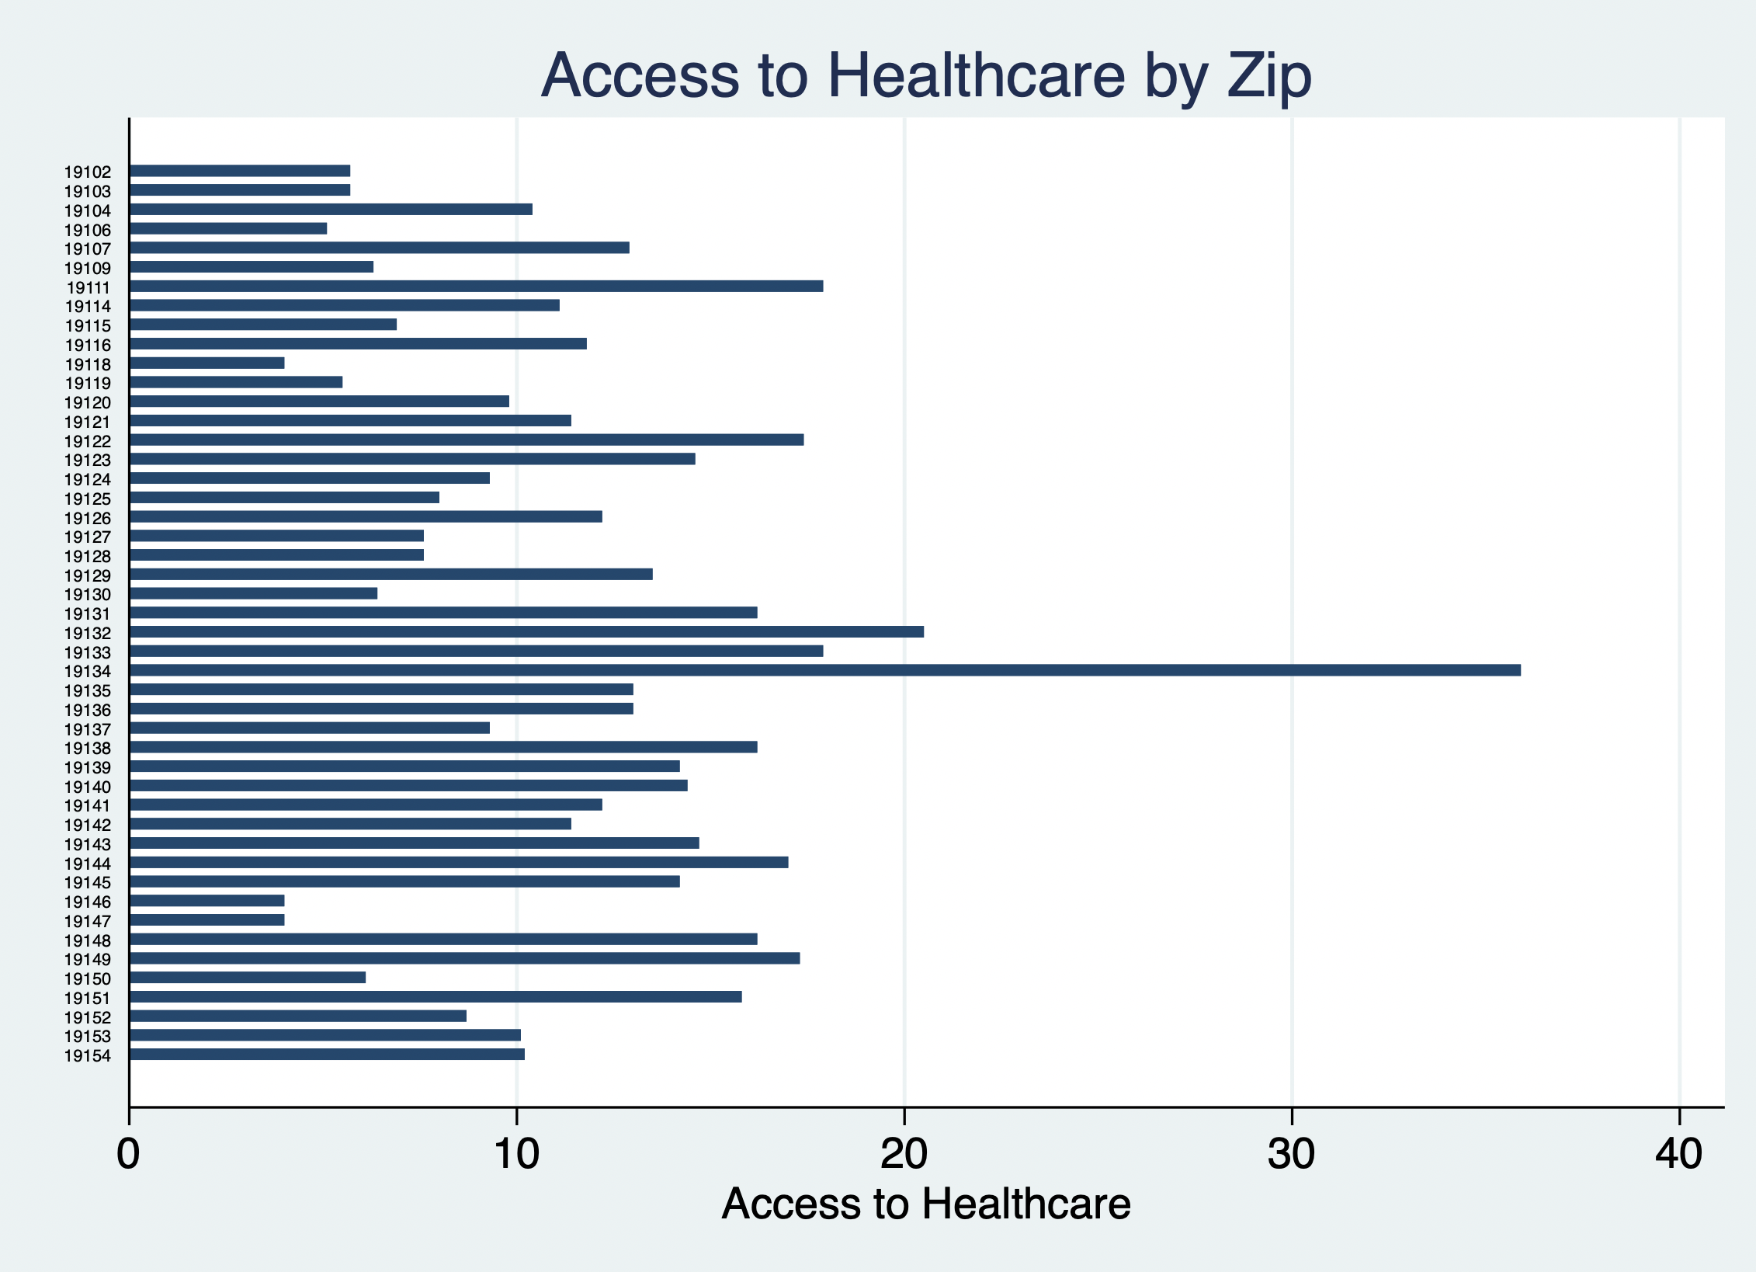
Zip 19134 is an area called Port Richmond

Slide 3
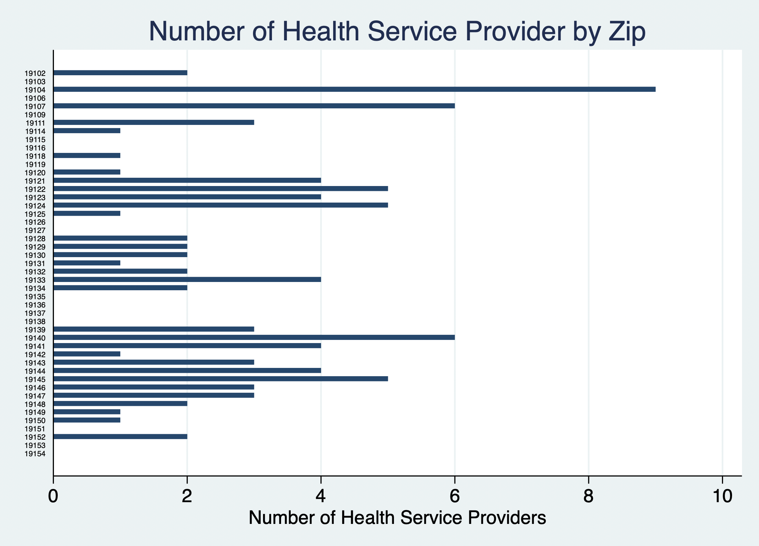
19104 is in West Philly

Slide 4
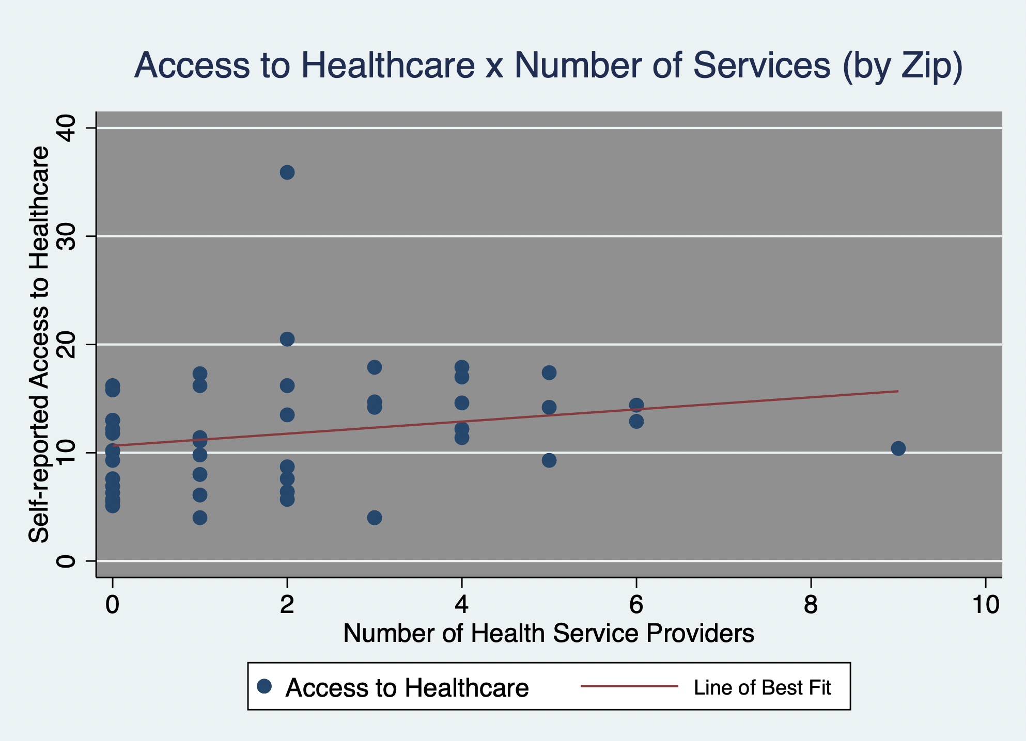
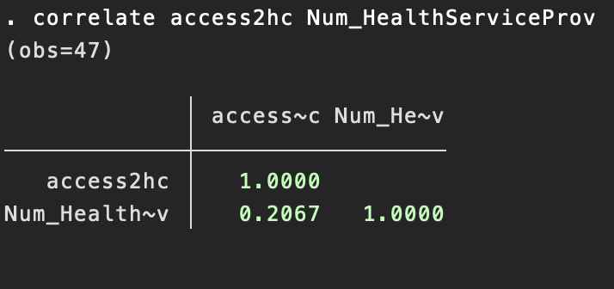
Mild correlation
r = .2067

Slide 5
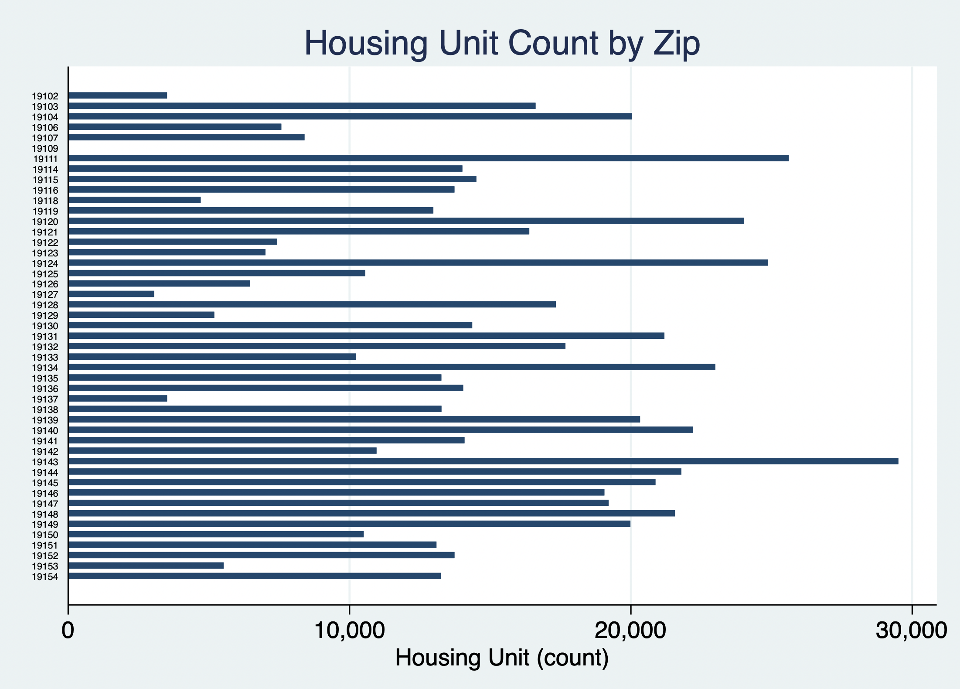

Slide 6
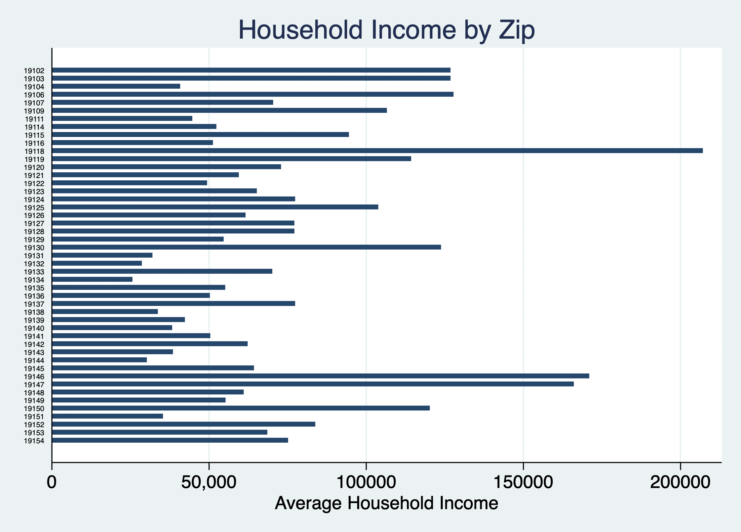

Slide 7
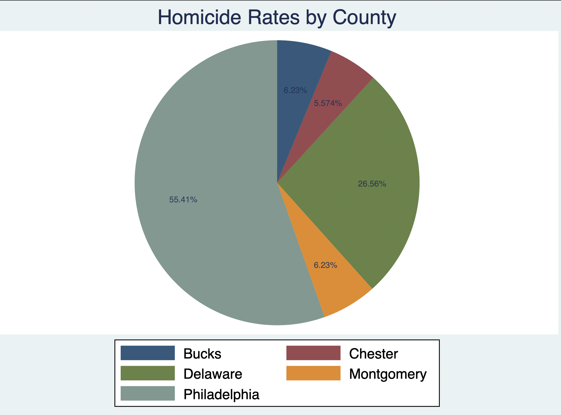
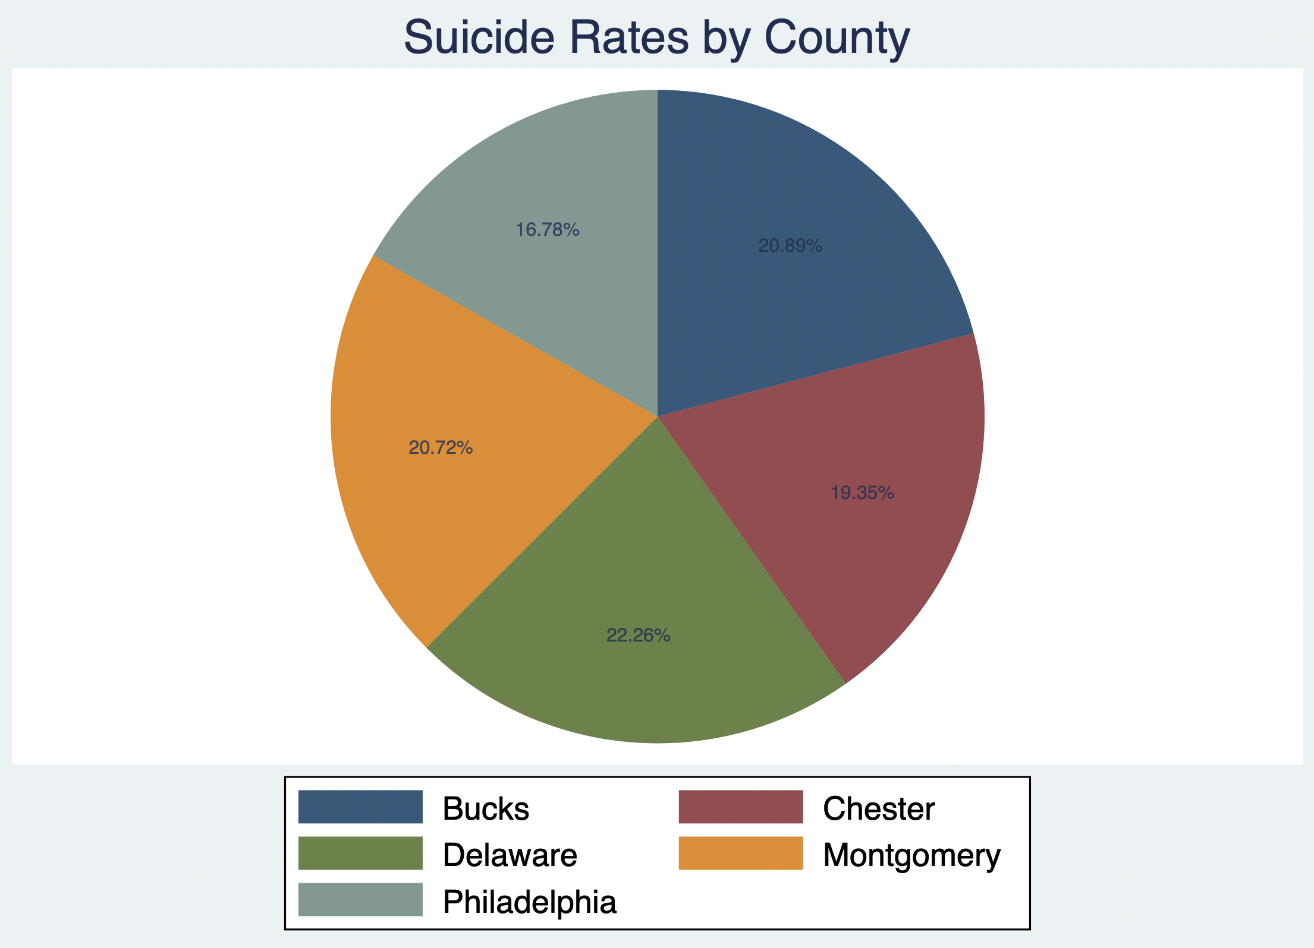
Side analysis: different death rates by county

